Slide 1
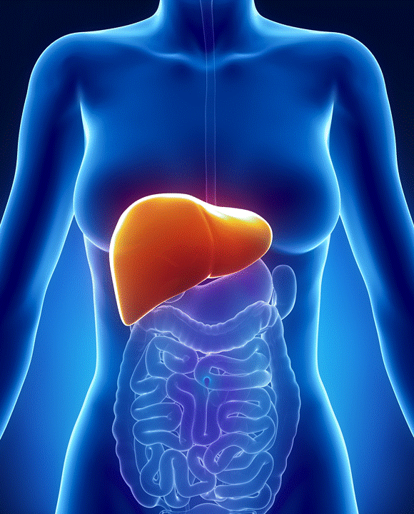

A REVIEW OF LIVER PATIENT ANALYSIS METHODS USING MACHINE LEARNING
DONE By
Team Id: NM2023TMID22698
R.BACKIA LAKSHMI (20326ER043)
S.DEVIPRIYA (20326ER045)
S.DIVYA (20326ER046)
M.DURGASRI (20326ER047)

Slide 2


CONTENT
Introduction
Problem definition & design thinking
Project description
Conclusion and future enhancenment
Screen layout

Slide 3
ABSTRACT
Liver diseases averts the normal function of the liver. This disease is caused by an assortment of elements that harm the liver. Diagnosis of liver infection at the preliminary stage is important for better treatment. In today’s scenario devices like sensors are used for detection of infections.
Accurate classification techniques are required for automatic identification of disease samples. This disease diagnosis is very costly and complicated. Therefore, the goal of this work is to evaluate the performance of different machine learning algorithms in order to reduce the high cost of liver disease diagnosis.
This project compares various classification algorithms such as random forest, logistic regression, KNN, and ANN algorithm with an aim to identify the best technique. Based on this study, random forest with the highest accuracy outperformed the other algorithms and can be further utilized in the prediction of liver disease and can be recommended to the user.

Slide 4
INTRODUCTION
OVER VIEW:
Liver disease is a significant health concern worldwide, and early prediction of liver disease can greatly aid in effective management and treatment. Machine learning algorithms, which are a type of artificial intelligence, have shown great potential in predicting liver disease by analyzing large amounts of data.
Liver disease prediction using machine learning algorithms typically involves several steps. First, a dataset containing relevant features or variables, such as patient age, gender, liver function tests, imaging findings, and medical history, is collected.
This dataset is then used to train and evaluate different machine learning algorithms. There are several commonly used machine learning algorithms for liver disease prediction, including logistic regression, decision trees, random forests.

Slide 5
PURPOSE
Liver disease prediction using machine learning algorithms has several potential benefits. It can help clinicians identify individuals at high risk for liver disease, allowing for early intervention and preventive measures. It can also assist in determining the optimal treatment plan for patients with liver disease and monitor disease progression over time.
However, there are also limitations to using machine learning algorithms for liver disease prediction. The quality and representativeness of the dataset used for training and testing the algorithms can greatly impact their performance. Additionally, machine learning algorithms are not a substitute for clinical judgment and should be used in conjunction with other diagnostic tools and medical expertise.

Slide 6
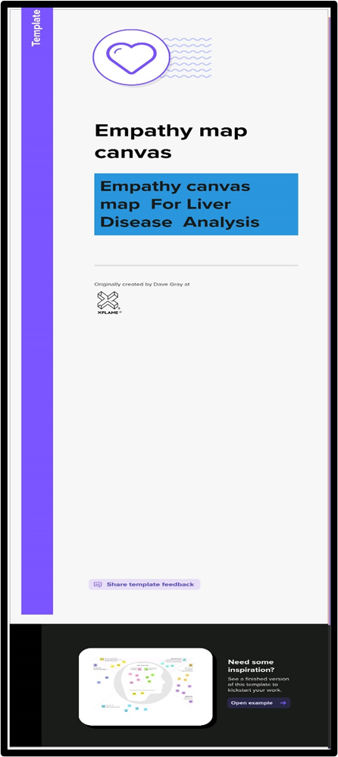
PROBLEM DEFINITION & DESIGN THINKING
EMPATHY MAP

Slide 7
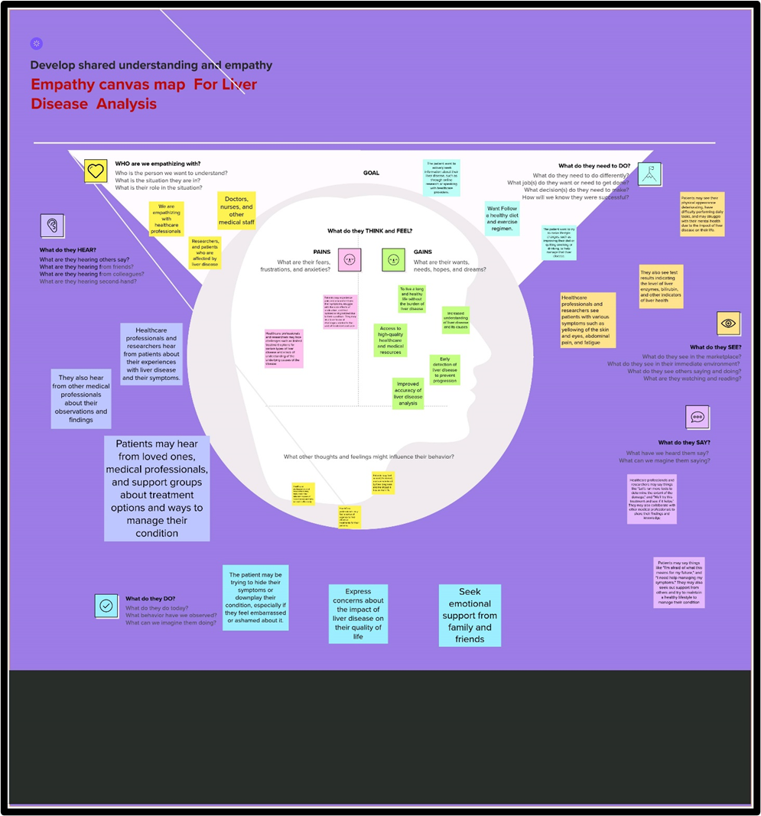

Slide 8
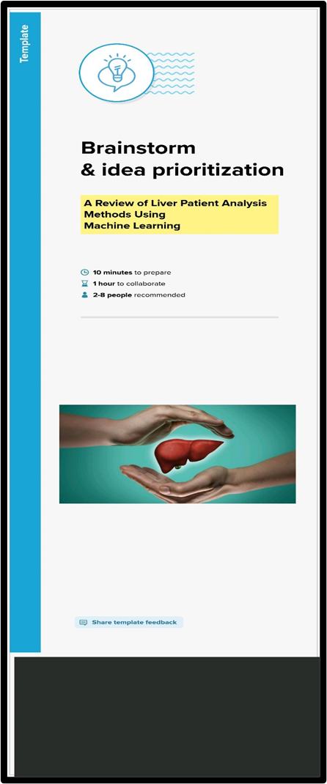
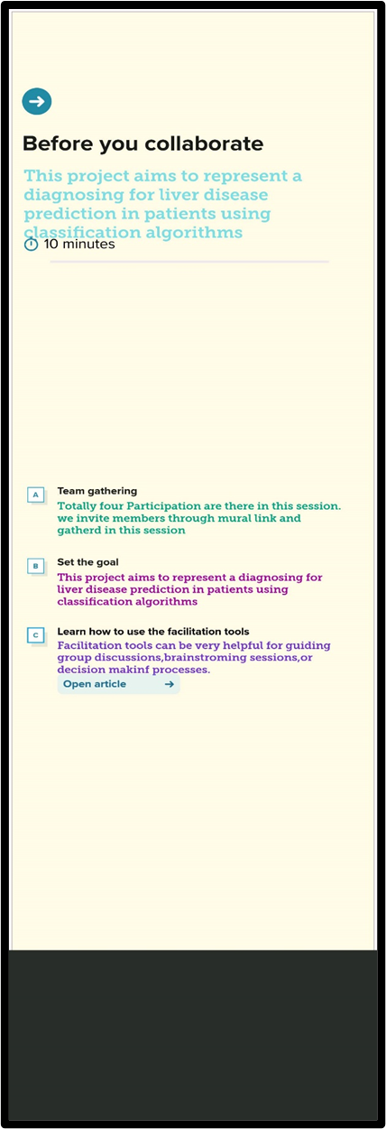
IDEATION & BRAINSTORMING MAP

Slide 9
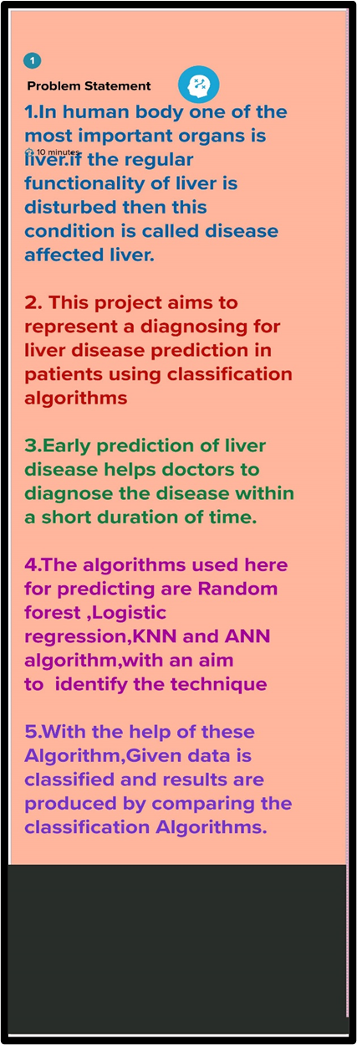
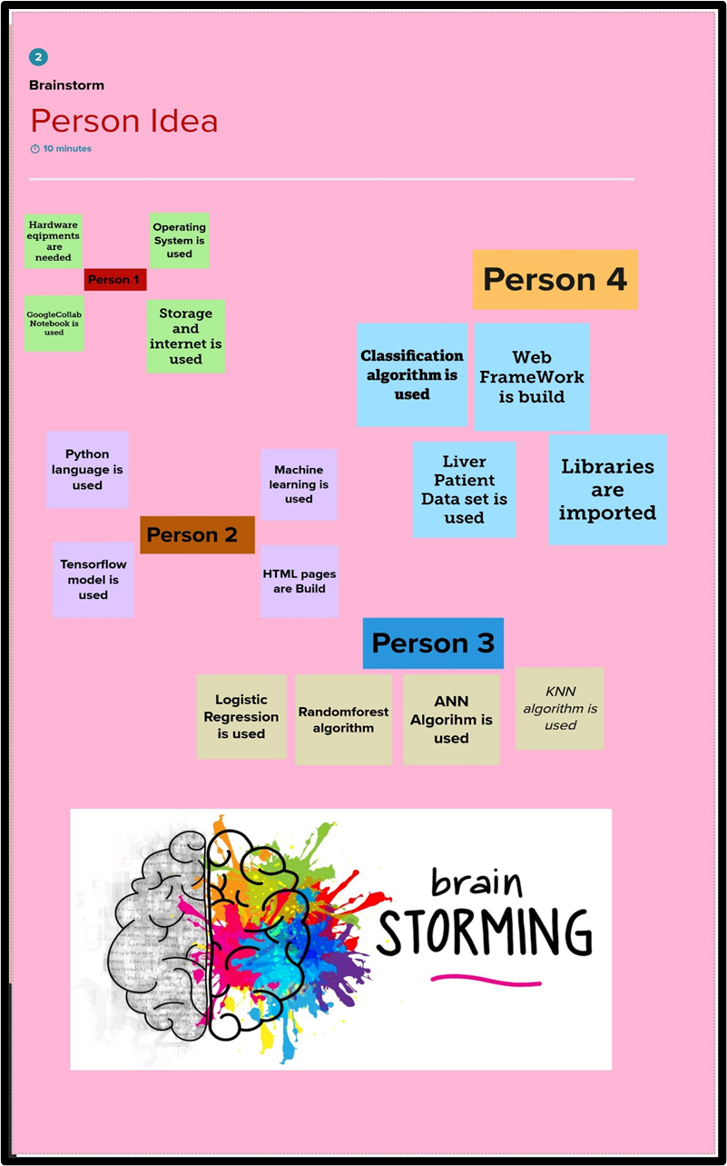

Slide 10
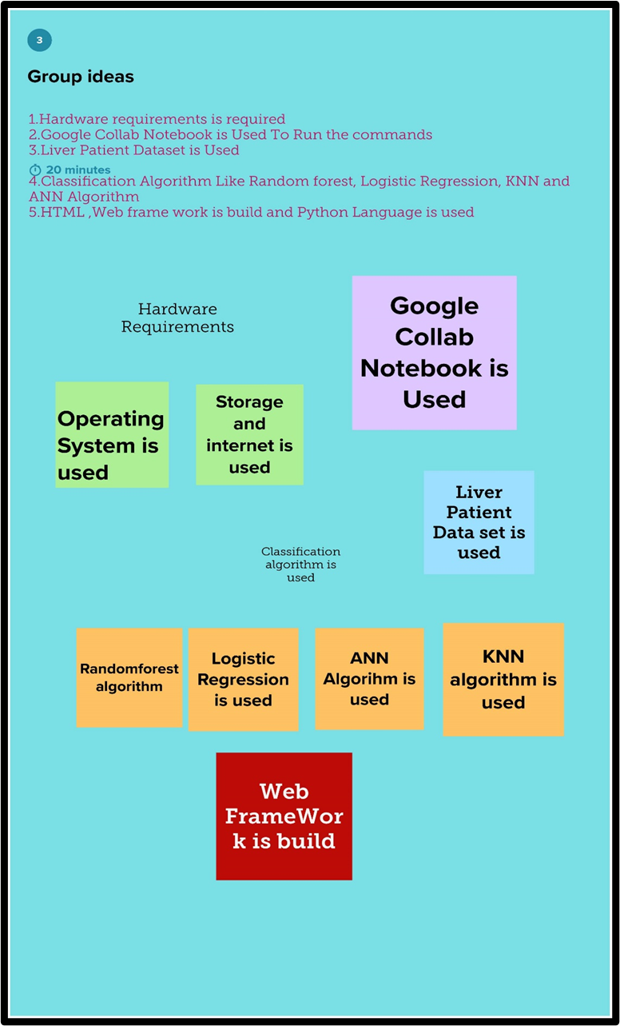
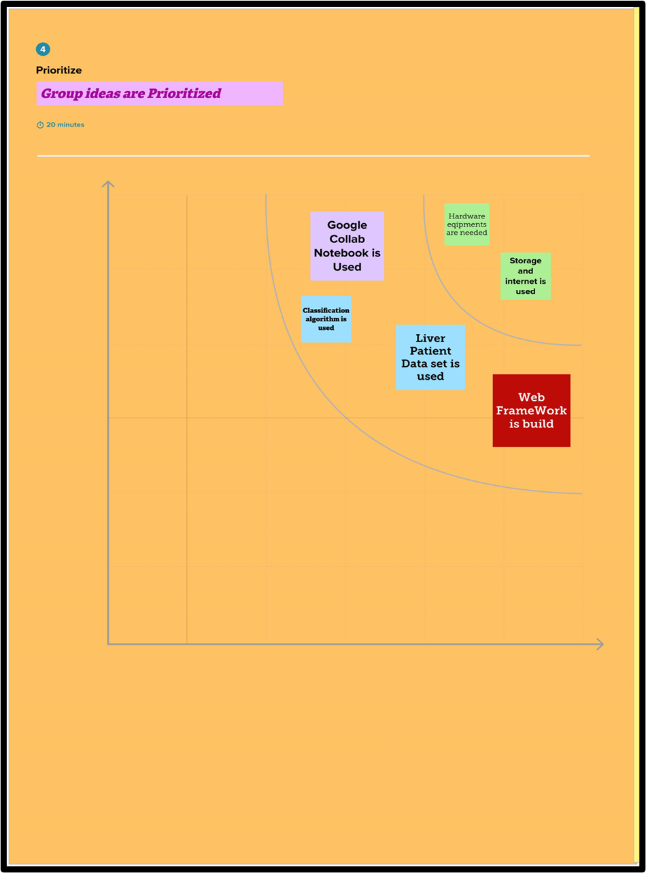

Slide 11
MODULES
1) DATA COLLECTION & PREPARATION
2) EXPLORATORY DATA ANALYSIS
3) MODEL BUILDING
4) PERFORMENCE TESTING & HYPERPARAMETER TUNING
5) MODEL DEPLOYMENT

Slide 12
DATA COLLECTION & PREPARATION
DATA COLLECTION:
Data collection for liver disease analysis typically involves gathering clinical and laboratory data from patients. This may include demographic information such as age, gender, and ethnicity, as well as medical history, lifestyle factors, and laboratory results such as serum levels of liver enzymes, bilirubin, and other biomarkers. The data may be collected from electronic medical records, laboratory databases, or through direct patient interactions.

Slide 13
DATA PREPARATION:
Data preprocessing techniques such as normalization, scaling, and feature selection are critical steps in preparing data for machine learning analysis. Normalization involves rescaling the values of numerical variables to a standard range, while scaling involves transforming the data to a standard distribution to facilitate analysis. Feature selection techniques help to identify the most relevant features for the machine learning models, while feature engineering involves creating new features based on existing ones to improve the accuracy of the models.

Slide 14
EXPLORATORY DATA ANALYSIS
Exploratory data analysis (EDA) is an approach to analyzing data that involves exploring and visualizing the data to identify patterns, trends, and relationships. EDA is an essential step in machine learning because it allows researchers to understand the data and develop insights that can guide the development of predictive models. EDA can involve various techniques such as data visualization, statistical analysis, and data transformation.
One common approach to analyzing liver patient data using machine learning is to develop classification models that can predict whether a patient has liver disease or not. These models typically use a combination of clinical data, such as liver enzyme levels, demographic data, and medical history, as well as genetic data.

Slide 15
MODEL BUILDING
Machine learning models can be broadly categorized into supervised learning and unsupervised learning models. Supervised learning models involve training the model using labeled data, where the outcome variable is known, and the model learns to predict the outcome variable based on the input features. Unsupervised learning models, on the other hand, do not rely on labeled data and instead learn to identify patterns and trends in the data. One common approach to building supervised learning models for liver patient data is to use classification algorithms, such as logistic regression, Random forest model,decision tree model and ANN model and KNN model These models use input features such as liver enzyme levels, demographic data, and medical history to predict whether a patient has liver disease or not. These models have shown promising results in accurately predicting liver disease in patients.

Slide 16
PERFORMENCE TESTING & HYPERPARAMETER TUNING
PERFORMANCE TESTING:
Performance testing is an essential step in evaluating the accuracy and reliability of machine learning models. One common approach to performance testing is to use cross-validation techniques, such as k-fold cross-validation, to evaluate the model's performance on different subsets of the data. Another approach is to use evaluation metrics, such as accuracy, precision, recall, and F1 score, to quantify the model's performance.

Slide 17
MODEL DEPLOYMENT
SAVE THE BEST MODEL
Saving the best model after comparing its performance using different evaluation metrics means selecting the model with the highest performance and saving its weights and configuration. This can be useful in avoiding the need to retrain the model every time it is needed and also to be able to use it in the future.

Slide 18

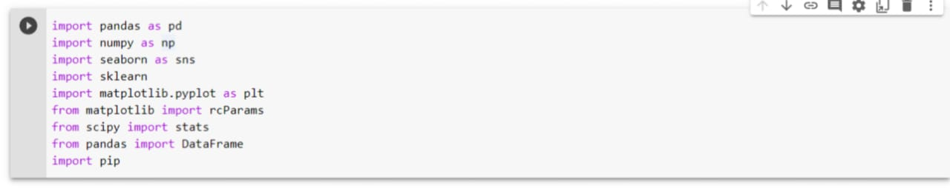
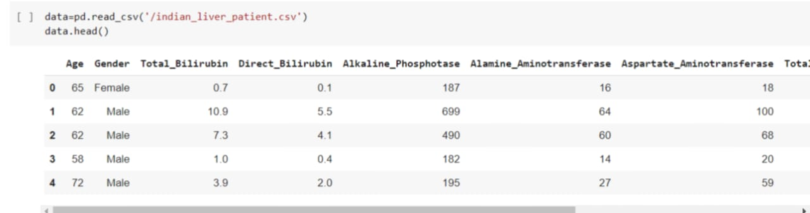
SCREEN LAYOUT

Slide 19
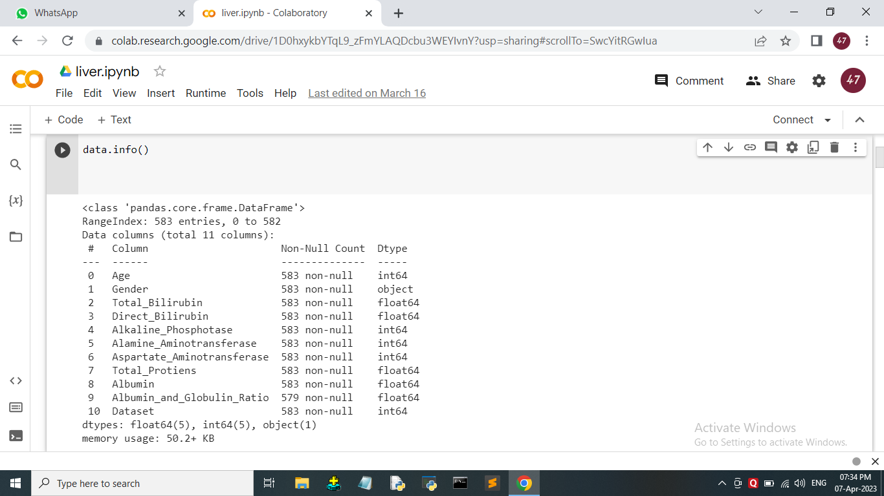

Slide 20
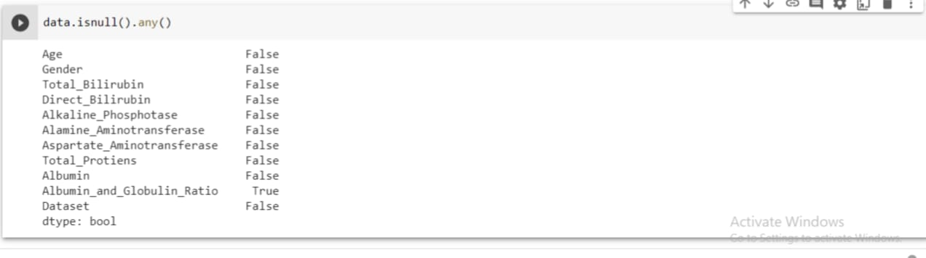
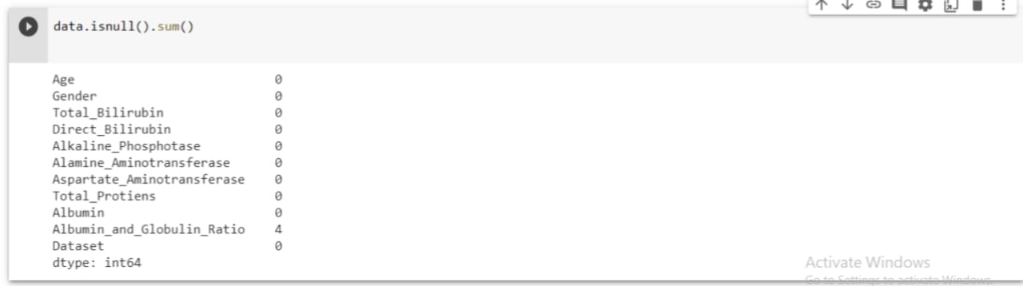

Slide 21
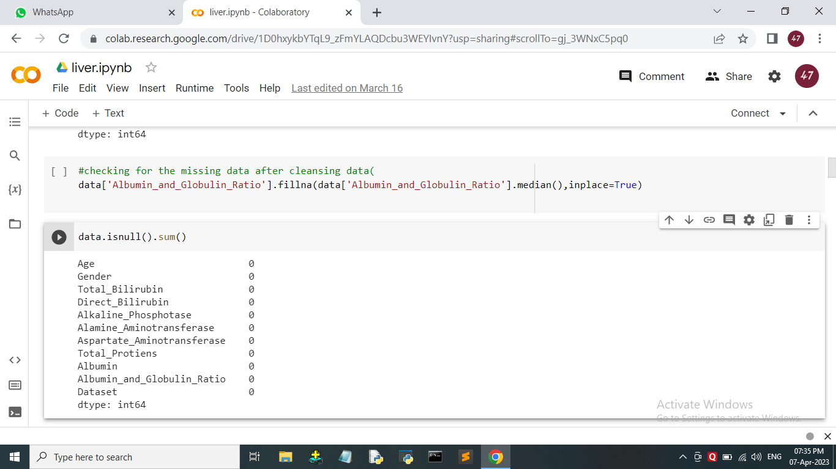

Slide 22
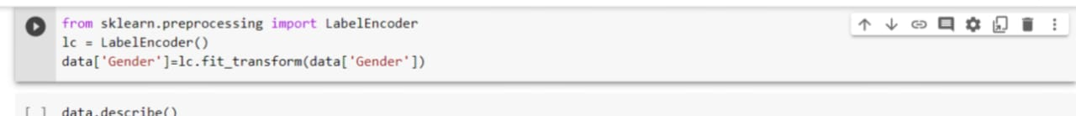
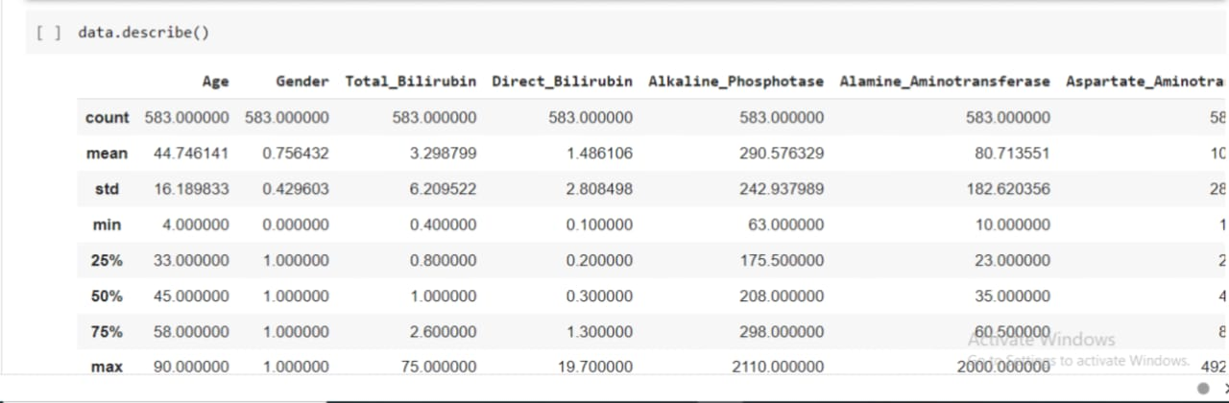
EXPLORATORY DATA ANALYSIS

Slide 23
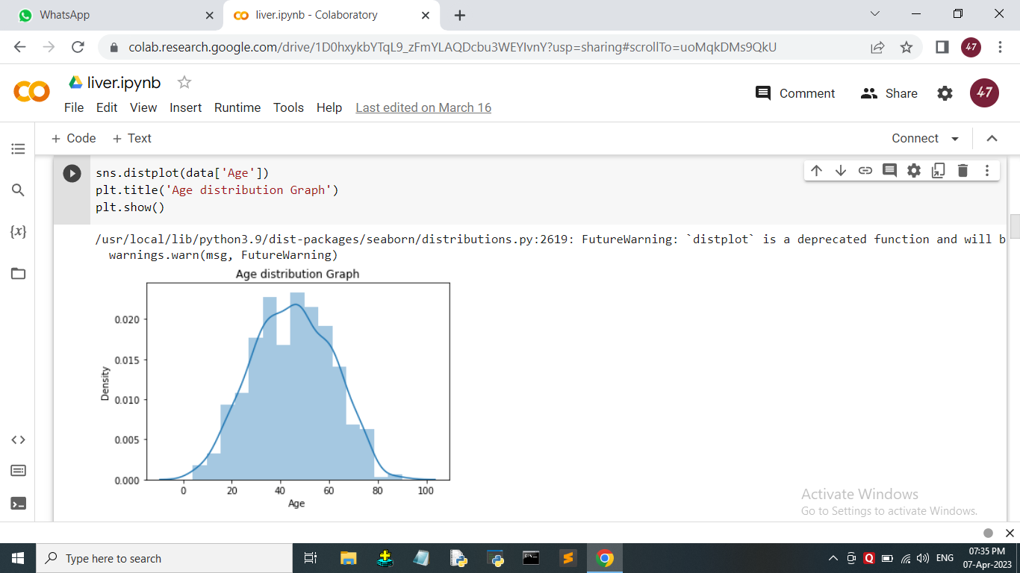

Slide 24
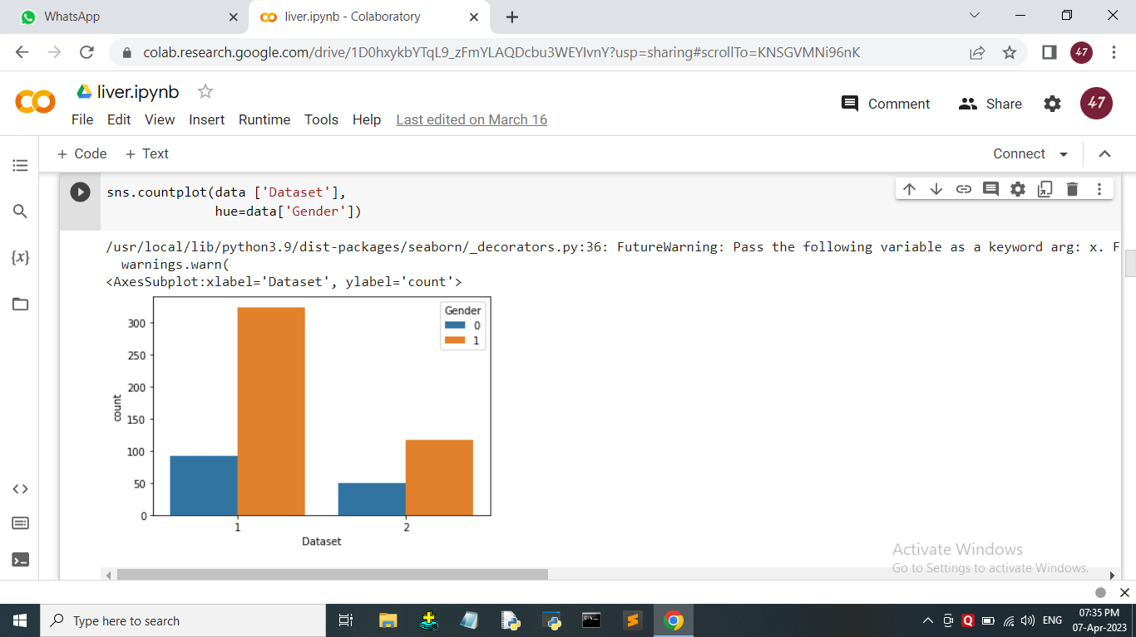

Slide 25
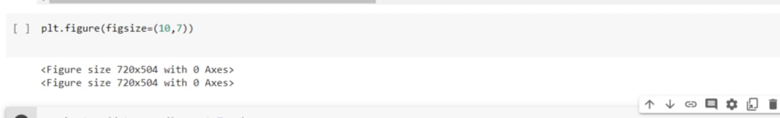
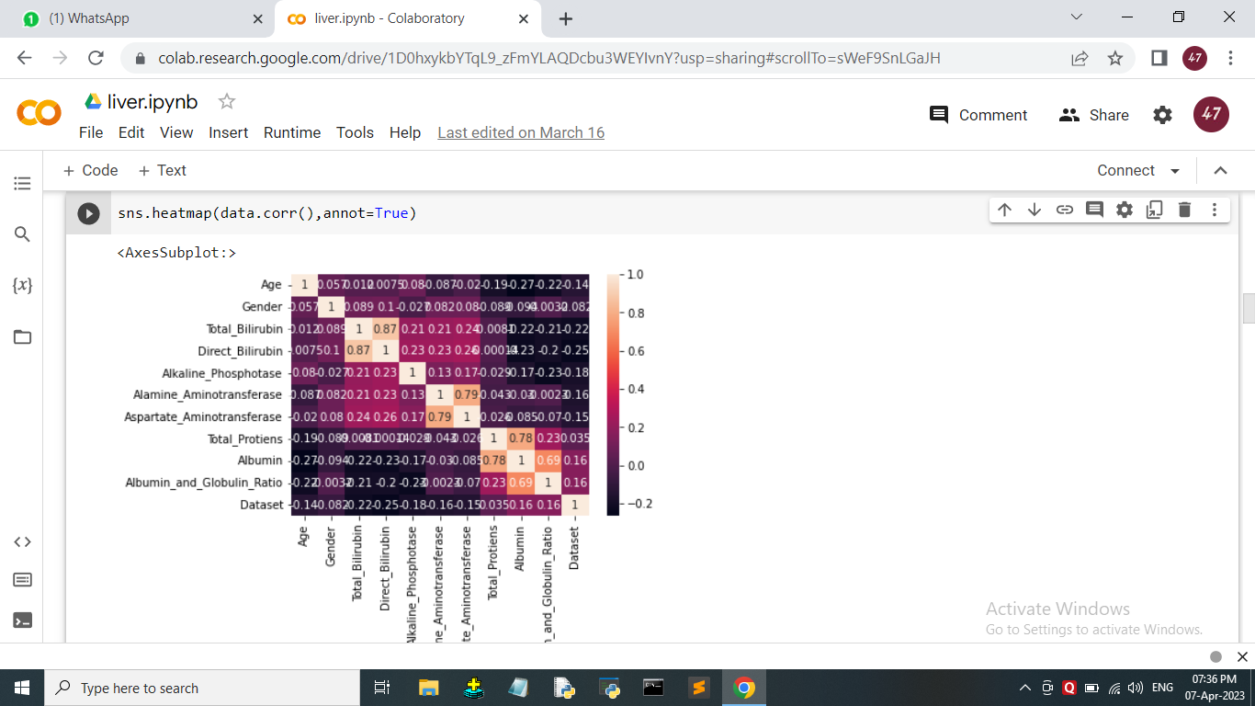

Slide 26
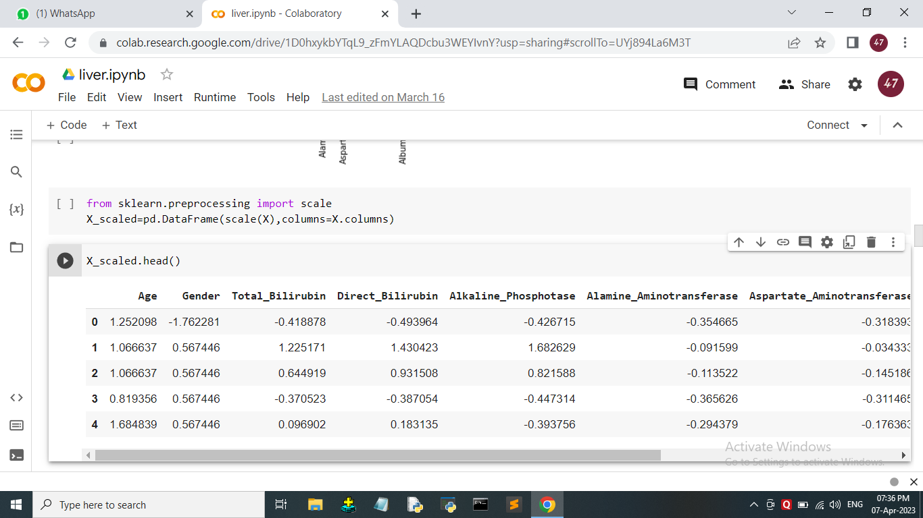

Slide 27
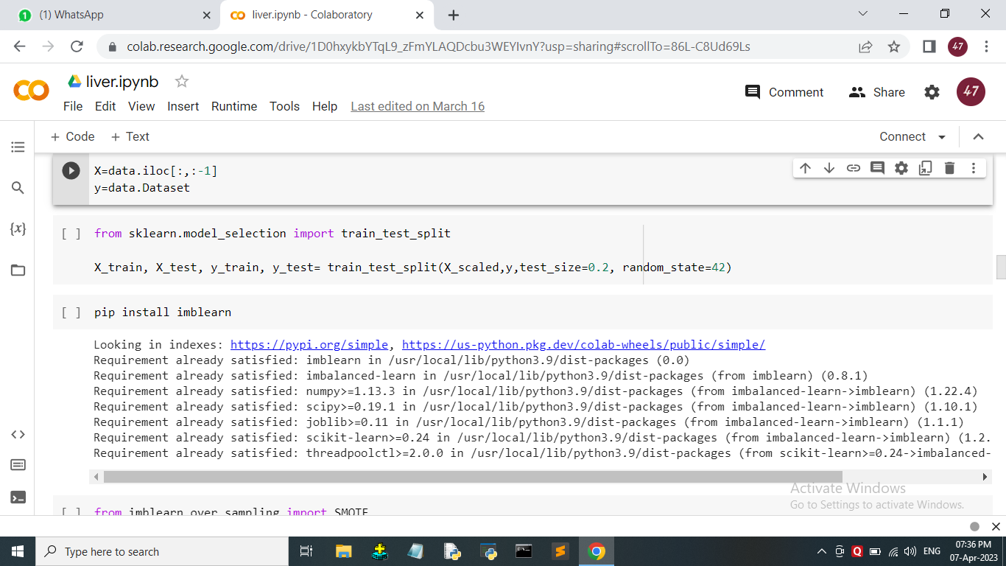

Slide 28
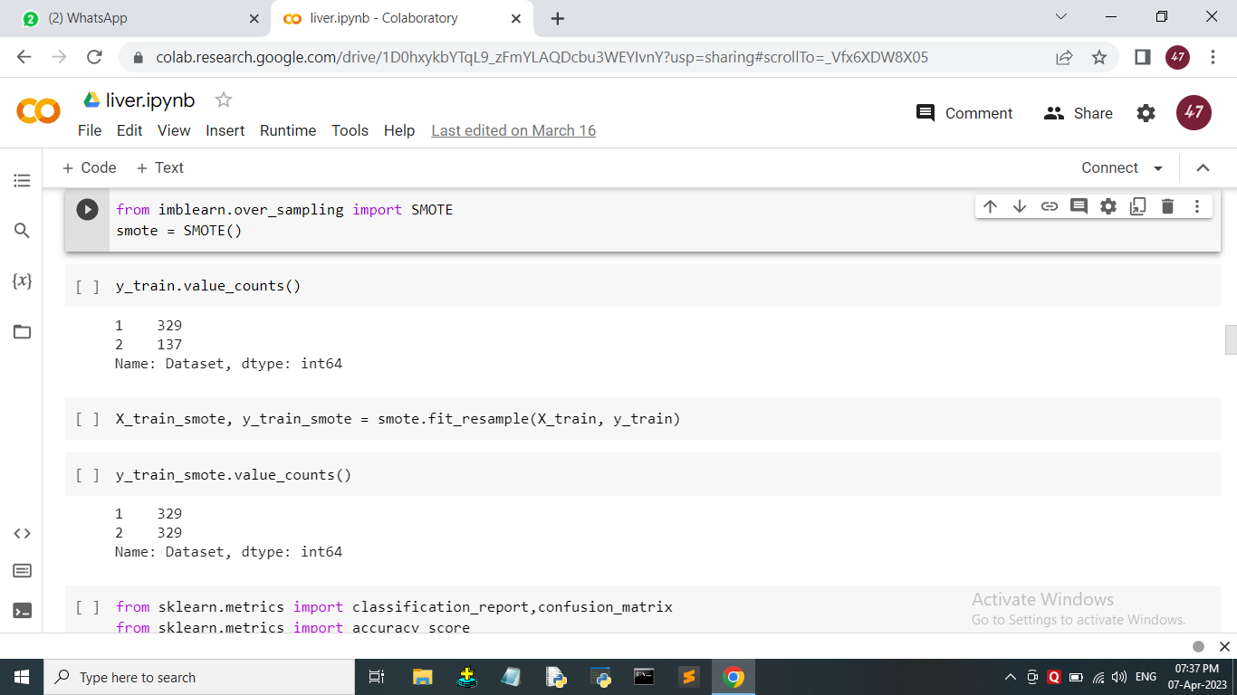

Slide 29
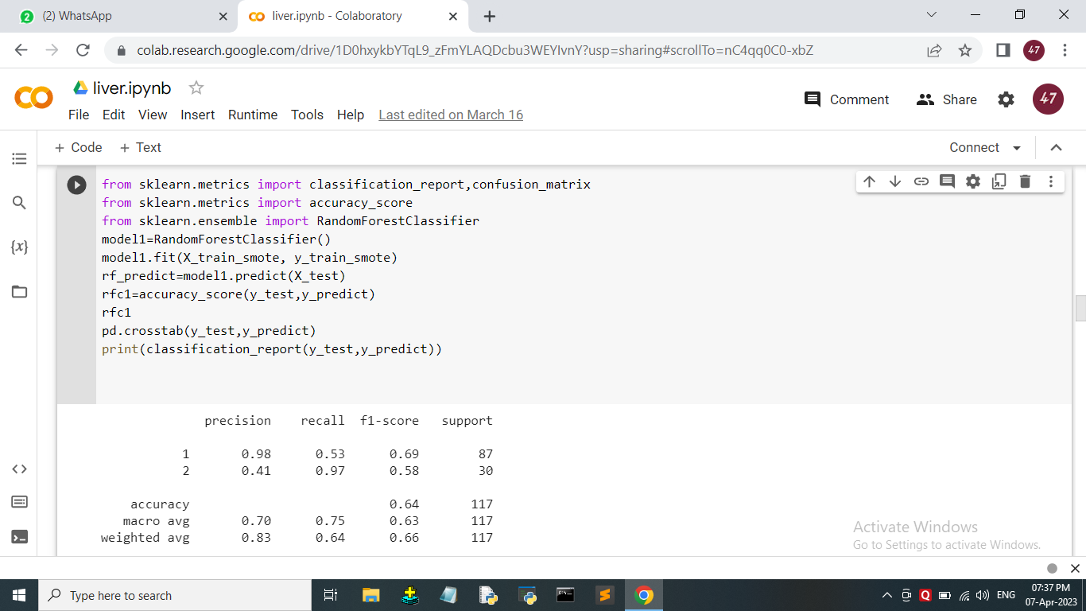
MODEL BUILDING

Slide 30
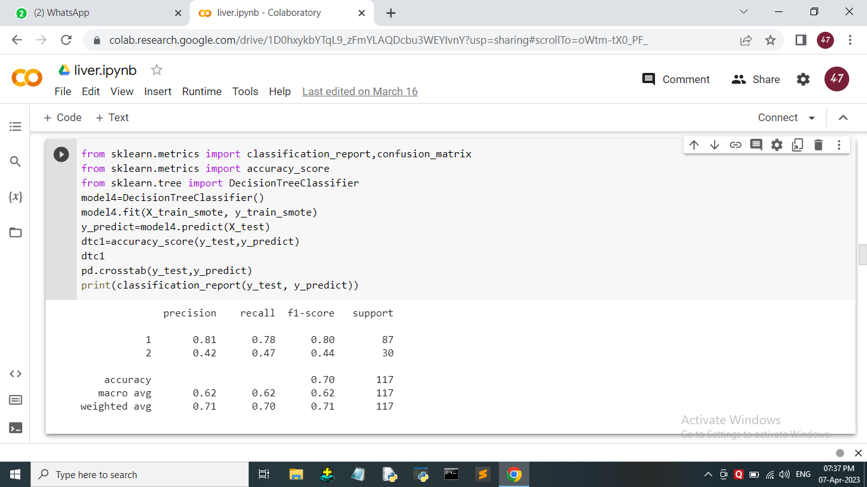

Slide 31


Slide 32


Slide 33
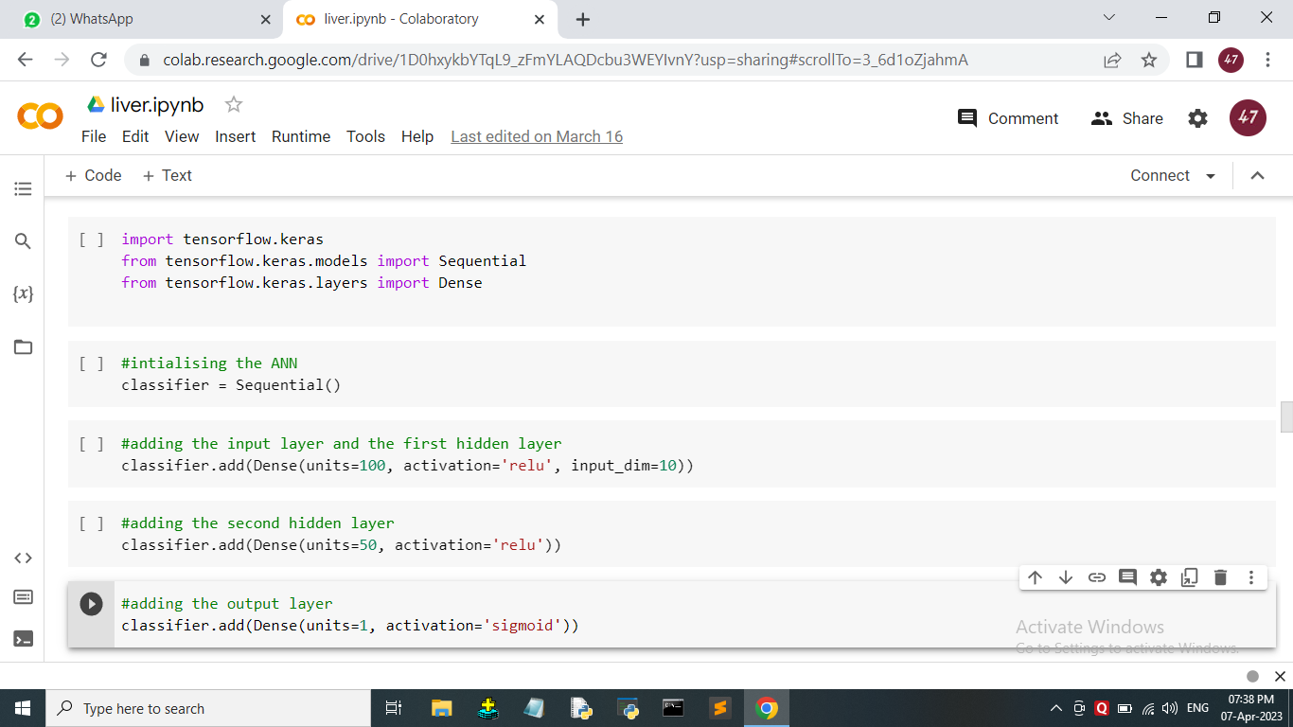

Slide 34
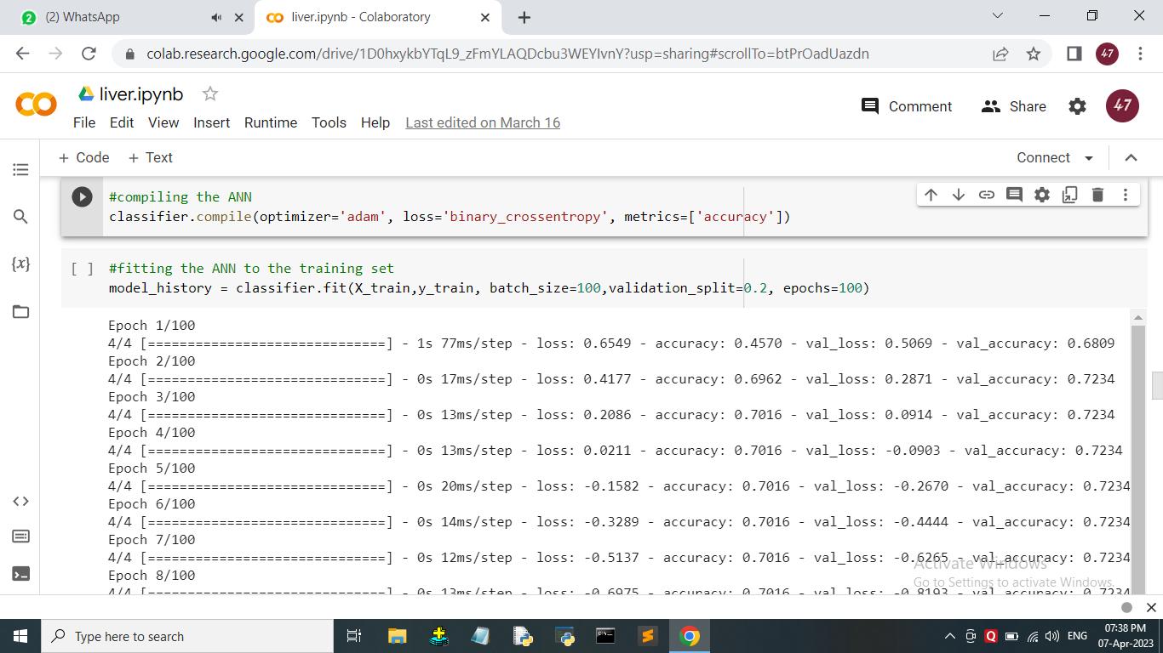

Slide 35
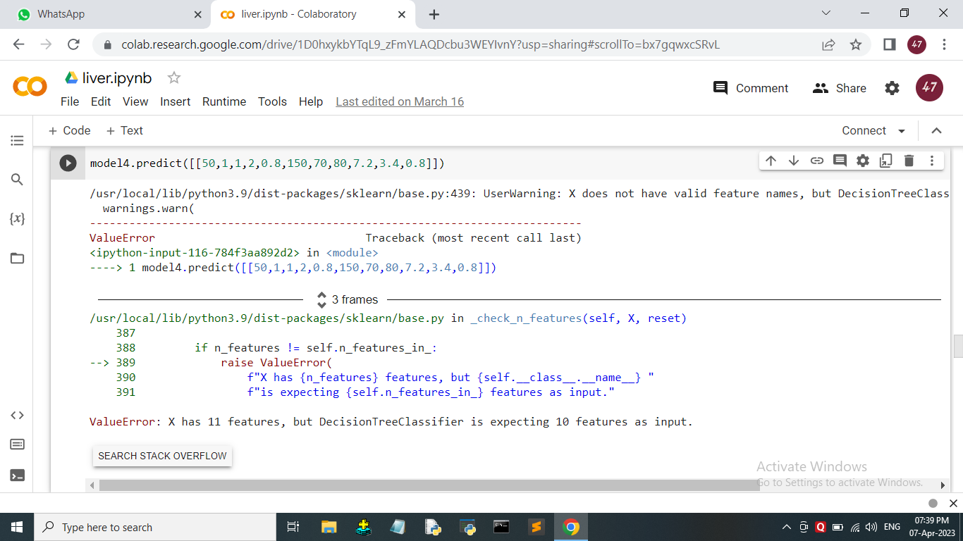

Slide 36
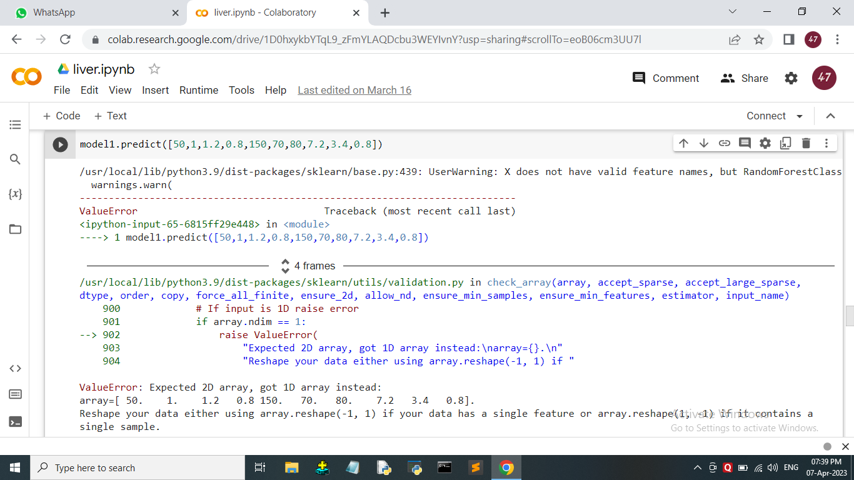

Slide 37
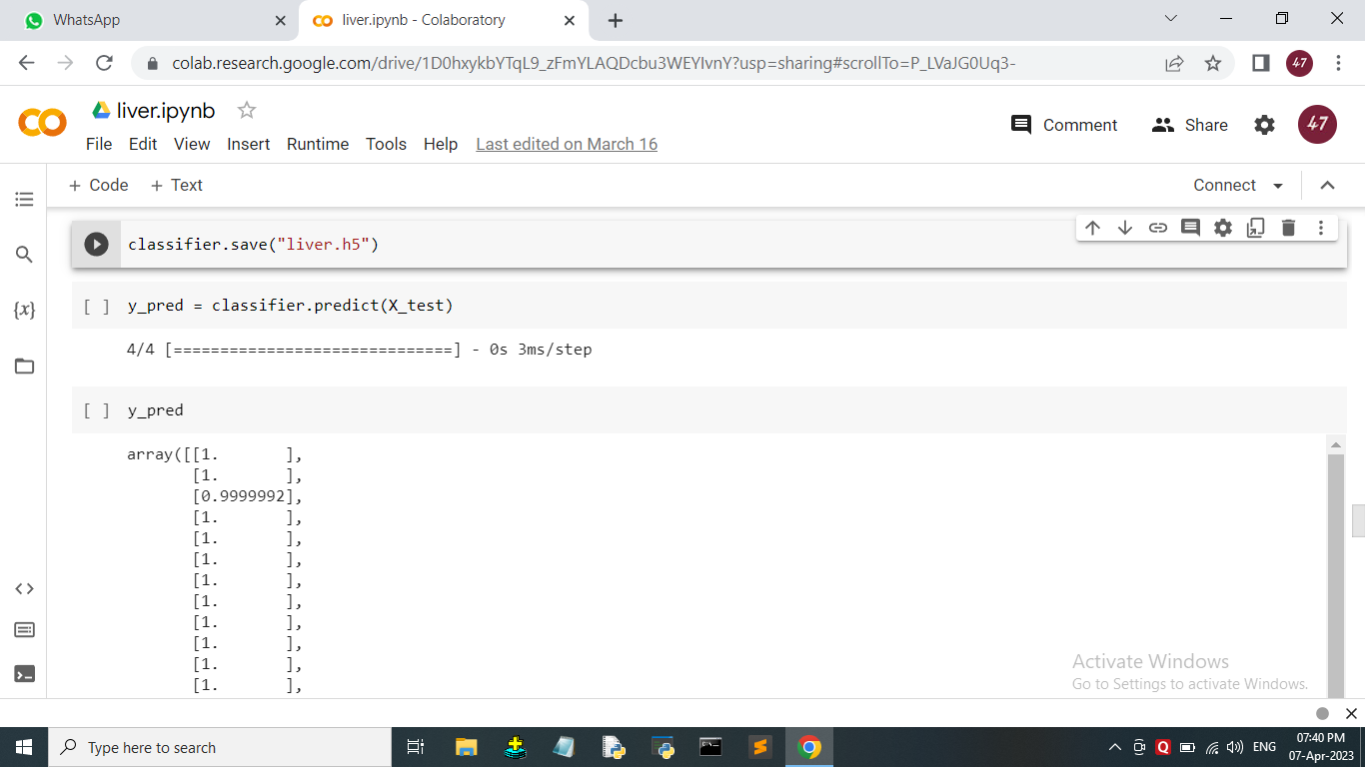

Slide 38
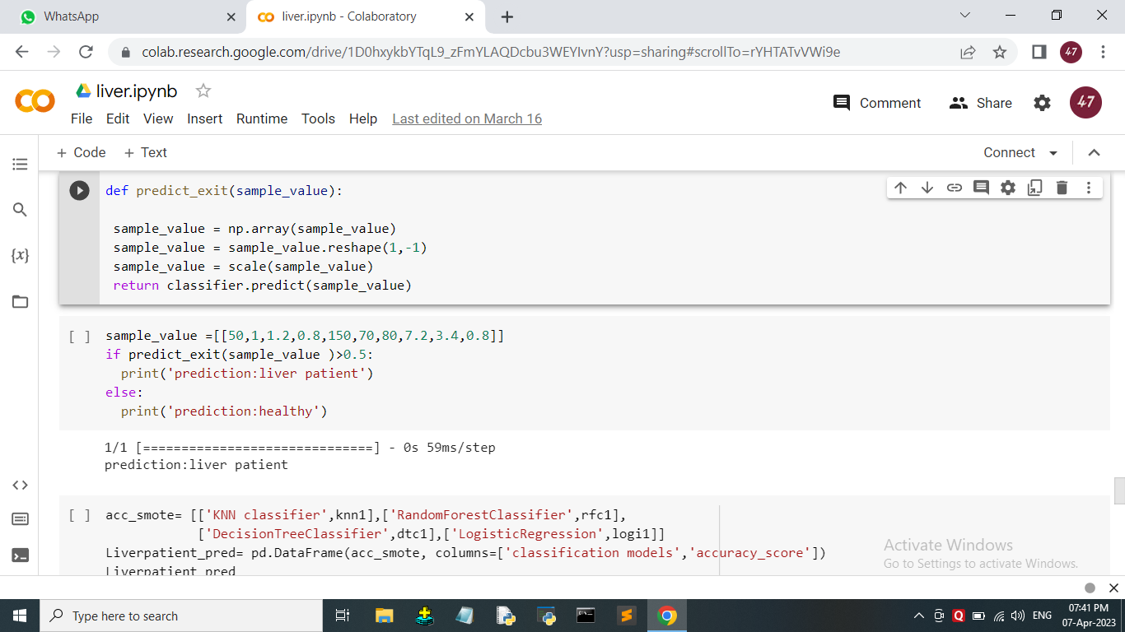

Slide 39
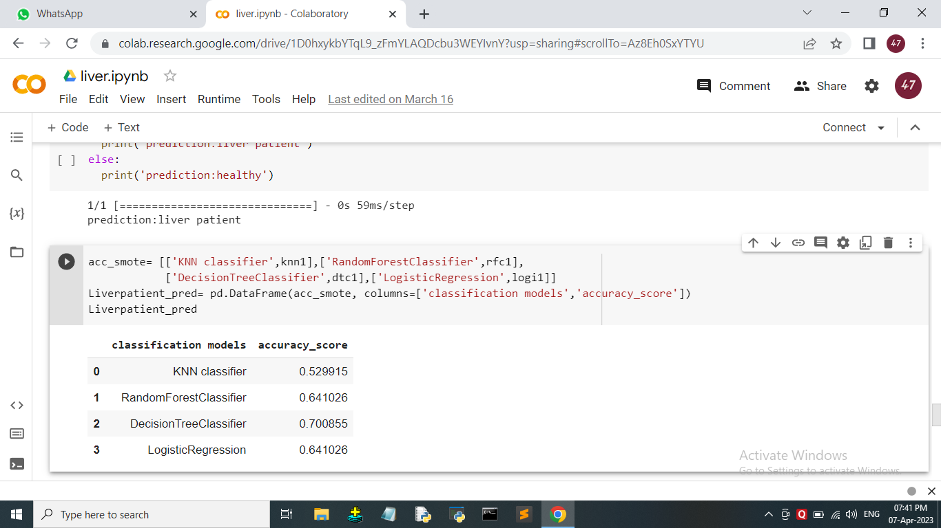

Slide 40
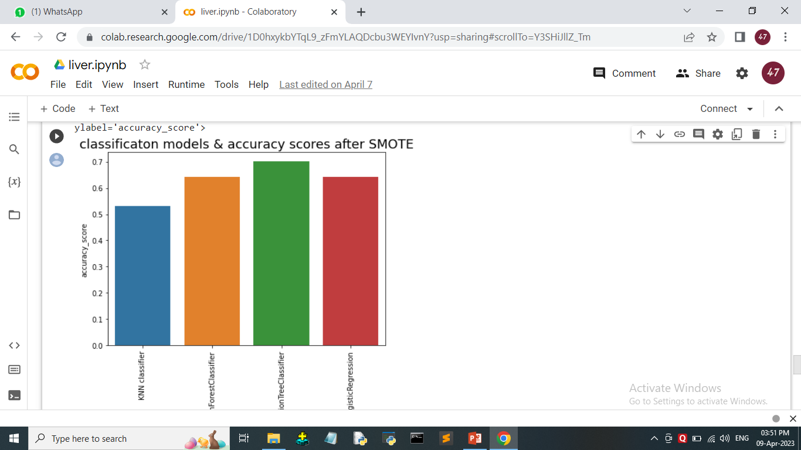

Slide 41
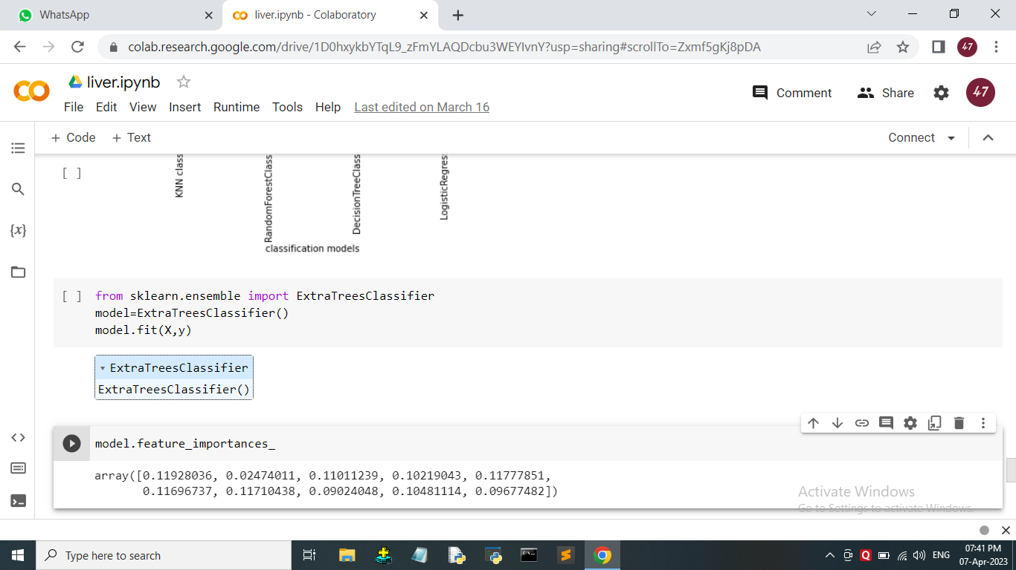

Slide 42
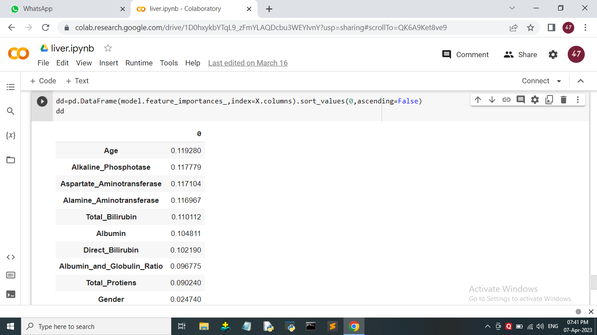

Slide 43
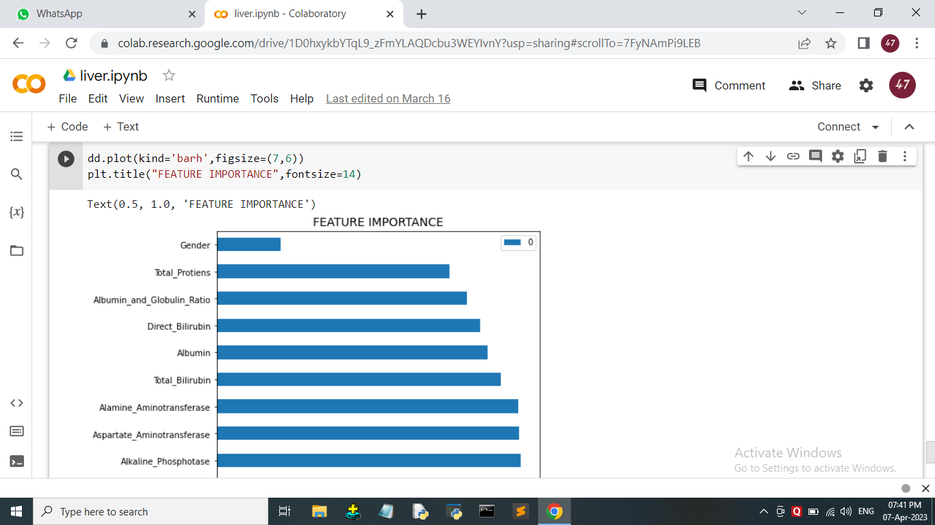

Slide 44

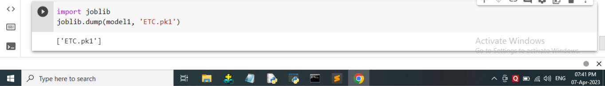

Slide 45
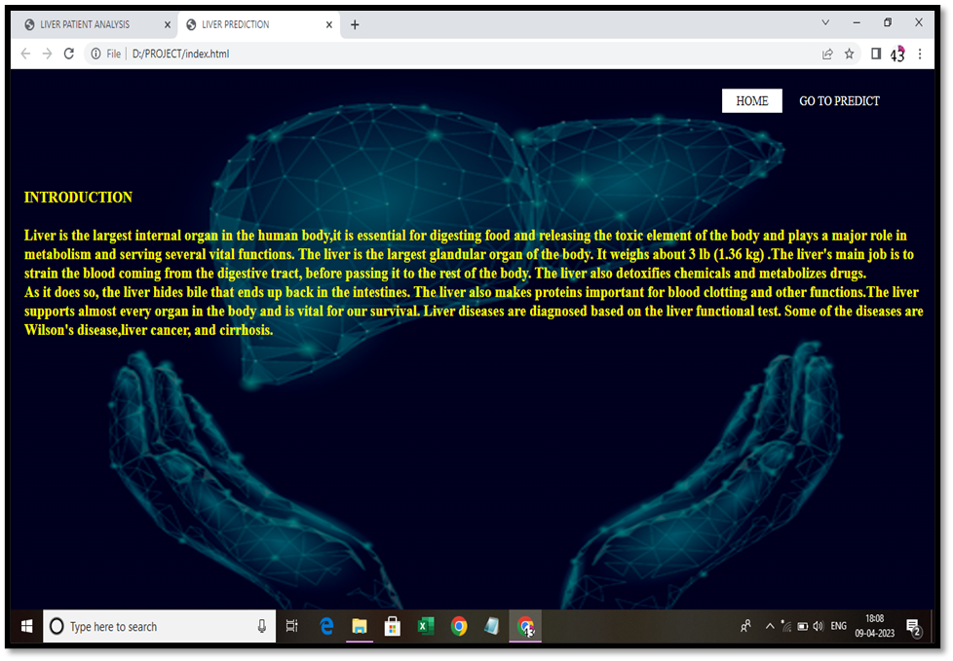
RESULT
LIVER DISEASE PREDICTION

Slide 46
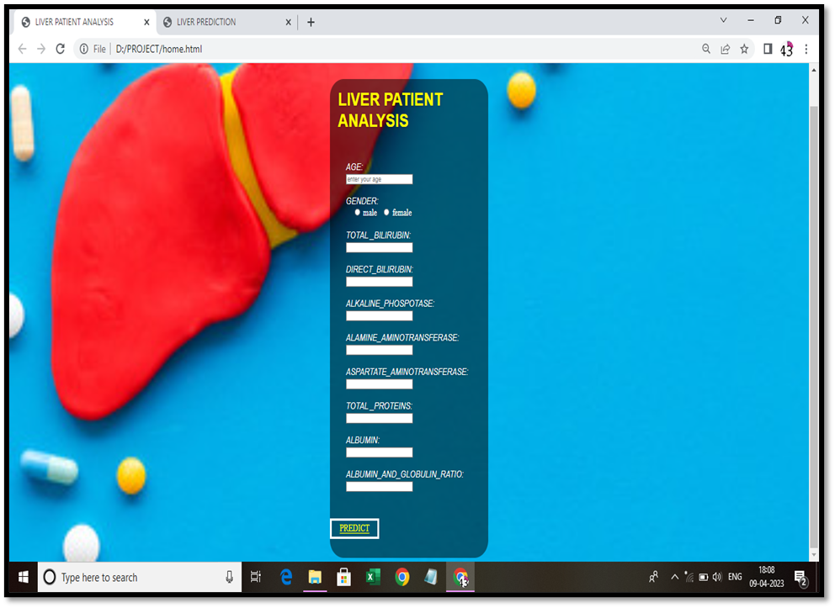

Slide 47
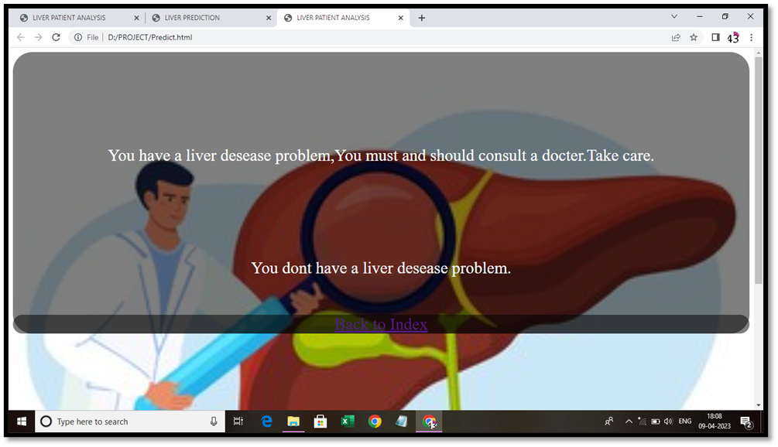

Slide 48
CONCLUSION
In conclusion, the use of machine learning methods in the analysis of liver patients has shown promising results in improving the accuracy and efficiency of diagnosis and prognosis.
Various studies have explored different techniques such as decision trees, artificial neural networks, support vector machines, and random forests, among others, in predicting liver disease severity, identifying potential biomarkers, and detecting liver cancer.
Overall, the integration of machine learning into liver patient analysis holds great potential for advancing our understanding and management of liver diseases.

Slide 49
FUTURE ENHANCEMENTS
Here are some potential future enhancements for a liver patient analysis and prediction project that uses classification algorithms such as Random Forest, Logistic Regression, KNN, and ANN:
Feature Engineering: Feature engineering is the process of selecting, transforming, and creating new features from the raw data to improve the performance of machine learning models. In the future, you could explore different feature engineering techniques to extract more relevant features from the liver patient data. This could include domain-specific feature engineering, such as incorporating liver-specific biomarkers or clinical indicators, or exploring advanced feature extraction techniques such as deep feature learning or feature selection algorithms

Slide 50
Model Ensemble: Ensemble methods, such as stacking, bagging, and boosting, can often improve the prediction accuracy of machine learning models. In the future, you could explore ensemble techniques to combine the predictions of multiple classification algorithms, such as Random Forest, Logistic Regression, KNN, and ANN, to create a more robust and accurate prediction model for liver patient analysis. This could involve experimenting with different ensemble strategies and evaluating their performance on the dataset.
Hyperparameter tuning: hyperparameters are parameters of machine learning algorithms that are not learned during training but need to be tuned to optimize model performance. In the future, you could explore different hyperparameter tuning techniques, such as grid search, random search, or Bayesian optimization, to find the optimal hyperparameter settings for the classification algorithms used in your liver patient analysis project. This could help improve the performance and generalization of the models

